Slide 1
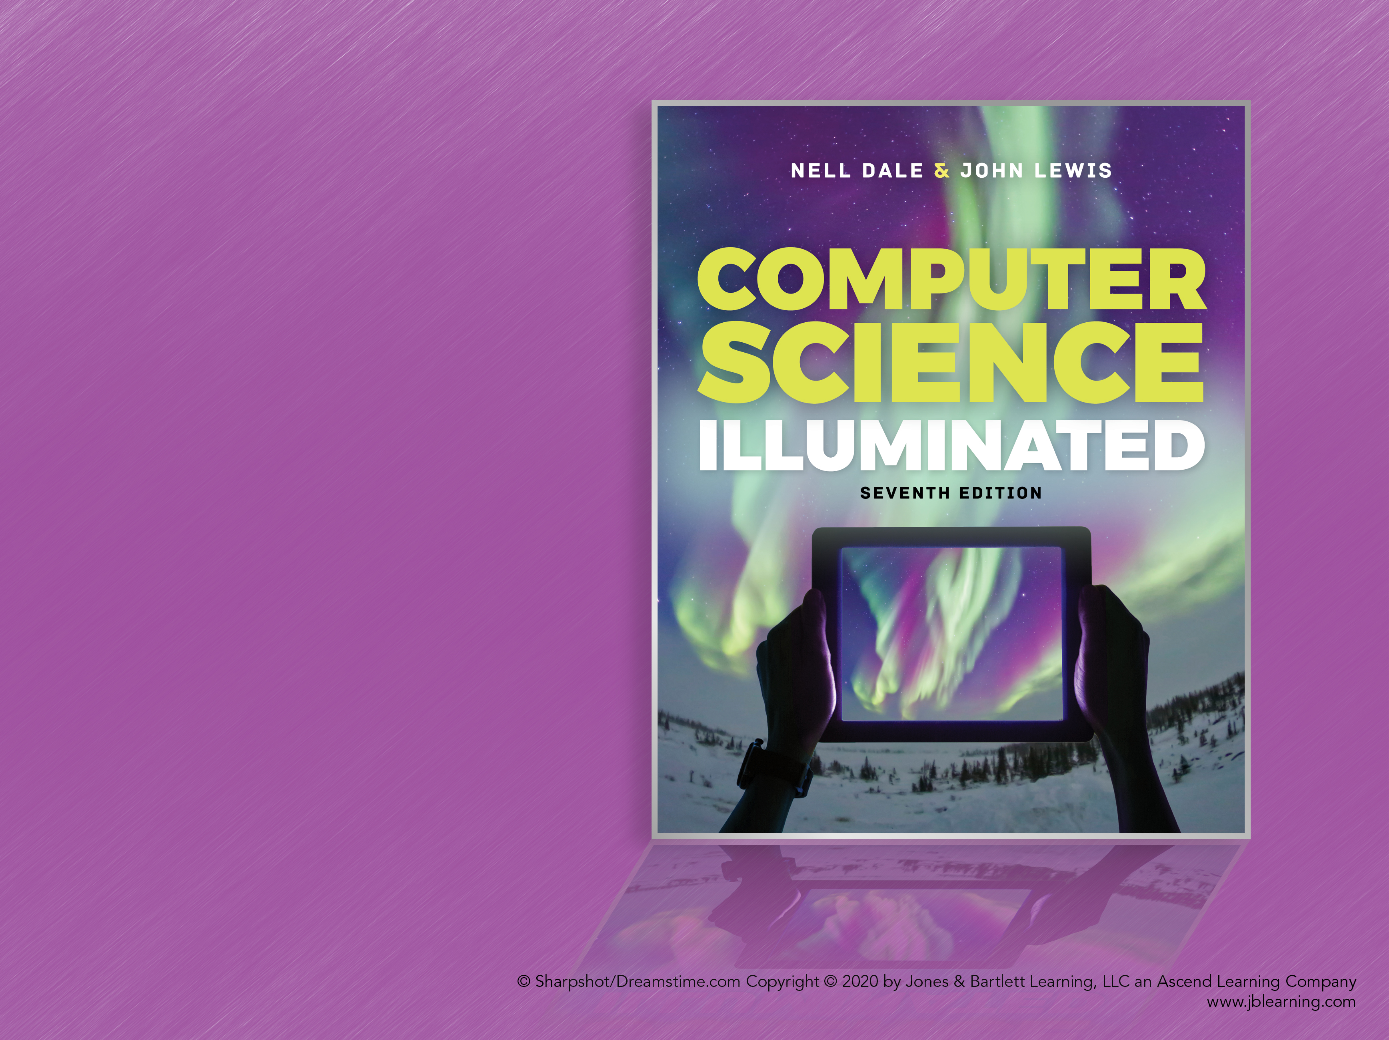
Chapter 17
Computer Security

Slide 2
Chapter Goals (1 of 2)
Discuss the CIA triad
List three types of authentication credentials
Create secure passwords and assess the security level of others
Define categories of malware
List the types of security attacks
Define cryptography

Slide 3
Chapter Goals (2 of 2)
Encode and decode messages using various ciphers
Discuss the challenges of keeping online data secure
Discuss the security issues related to social media and mobile devices

Slide 4
Information Security
Information Security
The techniques and policies used to ensure proper access to data
Cyber Security
The ability to protect resources accessible on the Internet

Slide 5
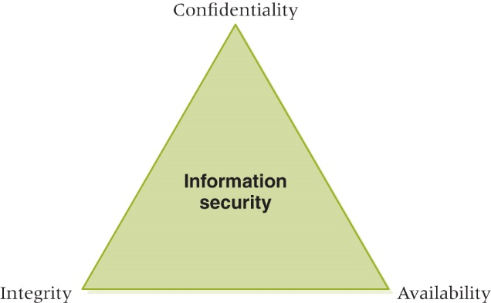
CIA Triad of Information Security
Ensuring
that data
can be
modified
only by
appropriate
mechanisms
Ensuring that data is
protected from
unauthorized access
The CIA triad of information security
The degree to which authorized
users can access information for
legitimate purposes

Slide 6
Information Security
Rick Analysis
Determining the nature and likelihood of the risks to key data
Planning for information analysis requires risk analysis
Goal is to minimize vulnerability to threats that put a system at the most risk

Slide 7
Preventing Unauthorized Access (1 of 5)
Authentication Credentials
Information users provide to identify themselves for computer access
User knowledge Name, password, PIN
Smart card A card with an embedded memory chip used for identification
Biometrics Human characteristics such as fingerprints, retina or voice patterns

Slide 8
Preventing Unauthorized Access (2 of 5)
Guidelines for passwords
Easy to remember, hard to guess
Don’t use family or pet names
Don’t make it accessible
Use combination uppercase/lowercase letters, digits, and special characters
Don’t leave computer when logged in
Don’t ever tell anyone
Don’t include in an email
Don’t use the same password in lots of places

Slide 9
Preventing Unauthorized Access (3 of 5)
Typical Password Criteria
Contain six or more characters
Contain at least one uppercase and one lowercase letter
Contain at least one digit
Contain at least one special character

Slide 10
Good or Bad?
nelldale
JohnLewis
GingerCat
Longhorns
aatnv.AATNV
One2Three
7December1939
red&whIte%blUe7
g&OoD#3PaSs
Terrible? Acceptable? Marginal? Good?

Slide 11
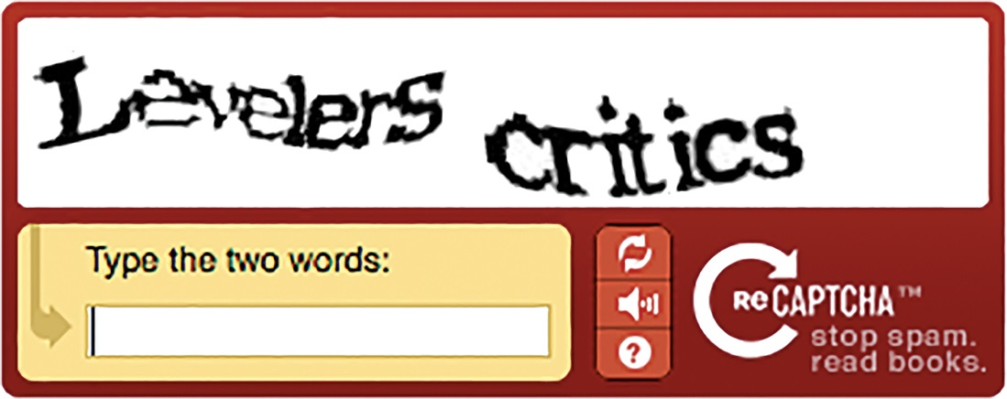
Preventing Unauthorized Access (4 of 5)
Courtesy of Google
A CAPTCHA form verification
CAPTCHA
Software that verifies that the user is not another computer
reCAPTCHA
Software that helps digitize books at the same time
© reCAPTCHA

Slide 12
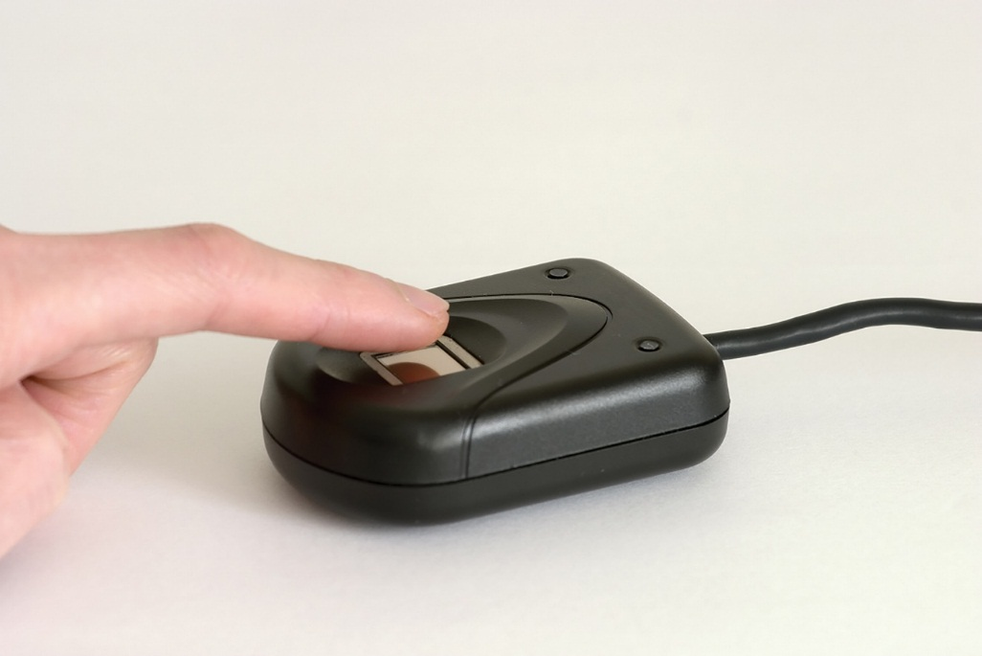
Preventing Unauthorized Access (5 of 5)
Fingerprint analysis: A stronger level of verification than username and password
What if somebody steals your digitized fingerprint?
© LongHa2006/Getty images
A fingerprint scanner

Slide 13
Computer Security (1 of 3)
Malicious Code
A computer program that attempts to bypass appropriate authorization and/or perform unauthorized functions
Worm stands alone, targets network resources
Trojan horse disguised as benevolent resource
Virus self-replicating
Logic bomb set up to execute at system event

Slide 14
Antivirus Software
Software installed to detect and remove malicious code
Signature detection recognizes known malware and removes
Heuristics are strategies used to identify general patterns

Slide 15
Computer Security (2 of 3)
Security Attacks
An attack on the computer system itself
Password guessing Obvious
Phishing Trick users into revealing security information
Spoofing Malicious user masquerades as authorized user
Back door Unauthorized access to anyone who knows it exists

Slide 16
Computer Security (3 of 3)
Buffer overflow Defect that could cause a system to crash and leave the user with heightened privileges
Denial-of-service Attack that prevents authorized user from accessing the system
Man-in-the-middle Network communication is intercepted in an attempt to obtain key data
Have you ever experienced one of these?

Slide 17
Cryptography (1 of 4)
Cryptography
The field of study related to encoded information (comes from Greek word for "secret writing")
Encryption
The process of converting plaintext into ciphertext
Decryption
The process of converting ciphertext into plaintext

Slide 18
Cryptography (2 of 4)
Encryption
plaintext
message
ciphertext
message
Decryption
Encrypted(Information) cannot be read
Decrypted(Encrypted(Information)) can be

Slide 19
Cryptography (3 of 4)
Cipher
An algorithm used to encrypt and decrypt text
Key
The set of parameters that guide a cipher
Neither is any good without the other

Slide 20
Cryptography (4 of 4)
Substitution Cipher
A cipher that substitutes one character with another
Caesar Cipher
A substitution cipher that shifts characters a certain number of positions in the alphabet
Transposition Ciphers
A cipher that rearranges the order of existing characters in a message in a certain way (e.g., a route cipher)

Slide 21
Substitution cipher
A B C D E F G H I J K L M N O P Q R S T U V W X Y Z
D E F G H I J K L M N O P Q R S T U V W X Y Z A B C
Substitute the letters in the second row for the letters in the top row to encrypt a message
Encrypt(COMPUTER) gives FRPSXWHU
Substitute the letters in the first row for the letters in the second row to decrypt a message
Decrypt(Encrypt(COMPUTER)) gives COMPUTER
Why is this called the Caesar cipher?
What is the key?

Slide 22
Transposition Cipher
T O D A Y
+ I S + M
O N D A Y
Write the letters in a row of five, using '+' as a blank. Encrypt by starting spiraling inward from the top left moving counter clockwise
Encrypt(TODAY IS MONDAY) gives T+ONDAYMYADOIS+
Decrypt by recreating the grid and reading the letters across the row
The key are the dimensions of the grid and the route used to encrypt the data

Slide 23
Cryptanalysis
Cryptanalysis
The process of decrypting a message without knowing the cipher or the key used to encrypt it
Substitution and transposition ciphers are easy for modern computers to break
To protect information, more sophisticated schemes are needed

Slide 24
Public/Private Keys (1 of 2)
Public-Key Cryptography
An approach in which each user has two related keys, one public and one private
One's public key is distributed freely
A person encrypts an outgoing message, using the receiver's public key.
Only the receiver's private key can decrypt the message

Slide 25
Public/Private Keys (2 of 2)
Digital Signature
Data that are appended to a message, made from the message itself and the sender's private key, to ensure the authenticity of the message
Digital Certificate
A representation of a sender's authenticated public key used to minimize malicious forgeries

Slide 26
Protecting Online Information
Why are smart people dumb about protecting online information?
The Internet creates a false sense of anonymity
People make assumptions about how securely their information is being treated
People don’t think about the ramifications of sharing information

Slide 27
Security and Portable Devices
Smartphones, tablets, and laptops combined with GPS capabilities can pose ethical problems
Apple iPhone and Google log and transmit data about users
Law enforcement makes use of this data in criminal investigations
U.S. Customs and Border Protection asserted the authority to seize and copy information in portable electronic devices for any reason

Slide 28
WikiLeaks
What is a wiki?
What do you think of when you hear WikiLeaks?
Is WikiLeaks a wiki? If not, what is it?
What is the relationship between WikiLeaks and Britain’s Guardian newspaper?
Where is Julian Assange now?

Slide 29
Ethical Issues
Blogging
What is the blogosphere?
Give several examples of how blogs have made national headlines.
Should bloggers have the same protections as regular journalists? What did the U.S. Court of Appeals for the Ninth Circuit have to say about bloggers’ protections in January 2014?

Slide 30
Do You Know?
How has new technology given new life to the old barcode?
How are barcodes and RFIDs similar? How are they different?
At which company was the Blaster worm directed?
What do privacy advocates consider Orwellian?
What famous computer scientist was a code breaker during World War II?
What famous actor was removed from a commercial airliner because he refused to quit his game of Words With Friends?

